Slide 1
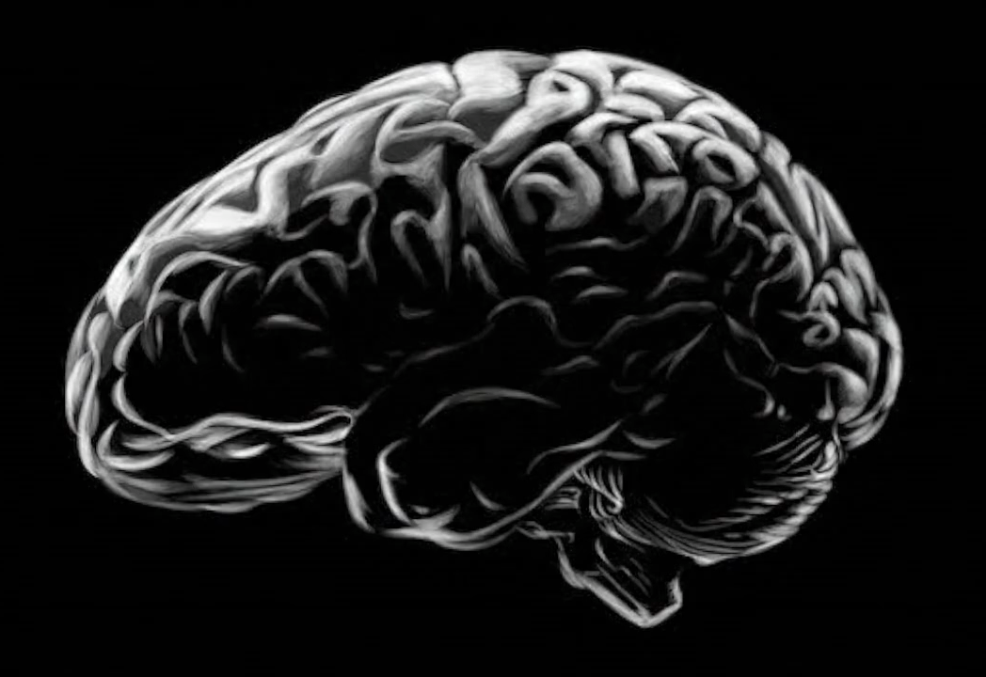

Zero-Point Architecture
For Intelligent machines
ZER
PA

